Slide 1
MCTS Guide to Microsoft Windows 7
Chapter 11
Application Support

Slide 2
Objectives
Describe application architecture terminology relevant to Windows 7
Describe supported application environments
Describe the Window 7 Registry and know how to manipulate it when necessary
Understand file and registry virtualization in conjunction with User Account Control
Know how to use the new Run As Administrator feature for applications
Understand how Windows 7 provides tweaked compatibility settings to run older applications
Describe application compatibility research tools provided by Microsoft
Describe application control policies that restrict which applications are allowed to run

Slide 3
Application Architecture
Evolved from the traditional Windows NT model
Windows 7 operates in a layered approach
  Different layers provide targeted functionality
  Conceptual layers add complexity
    Allow a controlled and secure flow
Windows 7 key components
  Environment subsystems
  Executive Services

Slide 4
Application Architecture (cont'd.)
Executive Services
  Provide the core operating system functionality that supports executing applications
  Multiple modules, such as the core kernel, object manager, memory manager, and several others
  Interact with each other and hardware directly
  Much hardware-specific knowledge is in the Hardware Abstraction Layer (HAL) service
  Run in kernel mode

Slide 5
Application Architecture (cont'd.)
Environment subsystems
  Support applications and provide indirect access to Executive Services
  Work together with the Executive Services to support running applications
  Run in user mode

Slide 6
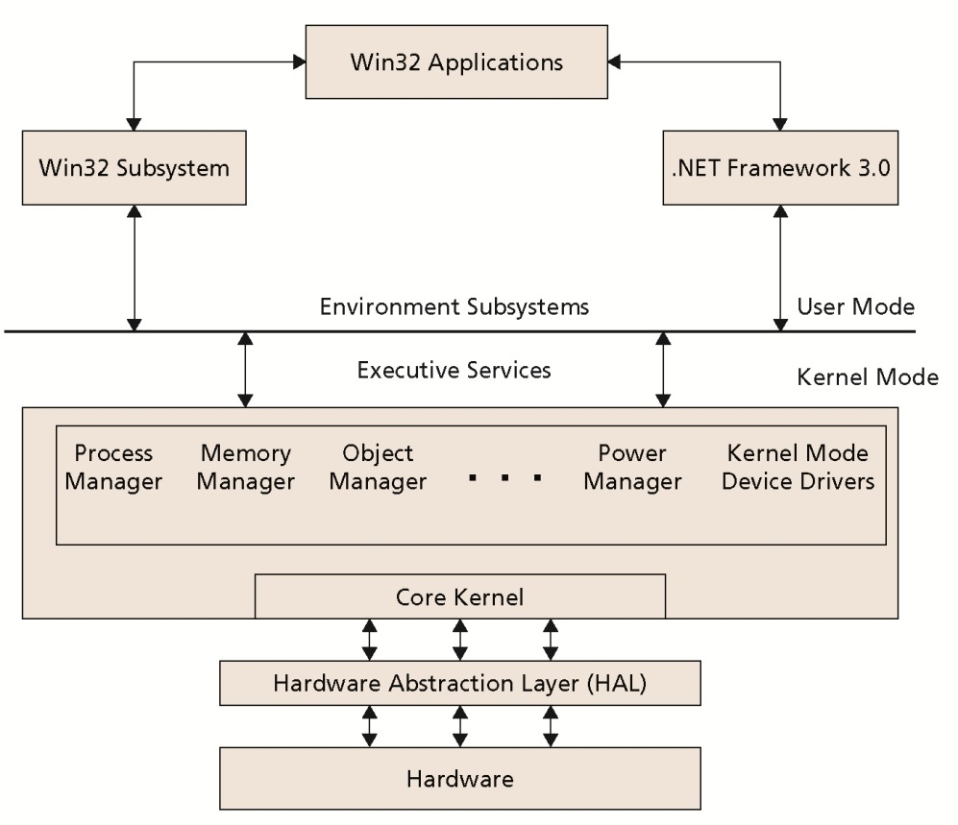
Application Architecture (cont'd.)

Slide 7
Supported Application Environments
Primary application types and special considerations
  Win32 Applications
  NET Applications
  DOS Applications
  Win16 Applications
  x64 Application Considerations

Slide 8
Win32 Applications
Most common type of application in use with Windows XP
Win32 application runs in its own virtual memory space
  Executed by the processor in user mode
If the Win32 application crashes, it will not affect:
  Other Win32 applications
  The operating system’s kernel Executive Services

Slide 9
.NET Applications
.NET Framework
  Preferred method for applications to access operating system services
  Ensures compatibility with future operating systems
  Isolates applications from any changes to the Win32 subsystem

Slide 10
DOS Applications
32-bit versions of Windows 7 support the execution of legacy DOS applications
When a legacy DOS application runs
  ntvdm.exe is started to create a Virtual DOS Machine (VDM) environment for the DOS application
DOS application appears to be running on a DOS computer
  Access to computer hardware is virtualized through ntvdm.exe and the Win32 subsystem
A new instance of ntvdm.exe is created for each DOS application that is executed

Slide 11
Win16 Applications
Win16 applications were originally designed to run with Windows 3.x
By default, a single Virtual DOS Machine is created to run all Win16 applications
  Instance of ntvdm.exe combined with Windows 3.x core operating system files
  An application shim called wowexec.exe
    Part of Windows 7 operating and supports Win16-on-Win32 execution
Applications cannot directly transfer information to the 32-bit Windows 7

Slide 12
Win16 Applications (cont'd.)
Thunking
  Translation of requests for service from the Win16 environment to 32-bit and vice-versa
All Win16 applications run in a single VDM by default
  Any one application that crashes can crash all other Win16 applications running with it in the VDM
Win16 environment can take a lot of time to initialize the first time it is started
  Once a Win16 VDM is created, it is not immediately shut down when all Win16 applications terminate

Slide 13
x64 Application Considerations
x64 version of Windows 7
  For use with new applications for 64-bit processors
Application compatibility is limited to Win32 application
  Win32-on-Win64 (WOW64) virtualized environment is created to host legacy Win32 applications

Slide 14
Windows 7 Registry
Registry
  Structure and security needed to centrally manage an application configuration and operational parameters
Windows 3.x introduced the concept of a registry
Windows 95 registry became a well defined and centrally required element
  In the operations of the operating system and applications

Slide 15
Registry Structure
Registry is divided into sections and levels of data
Multiple sections exist to organize data by purpose
  Individual sections are called hives
Within a single hive, data is stored in keys and values
  Identified by name and position relative to each other
Registry keys can contain sensitive information that can crash the computer
  If improperly configured

Slide 16
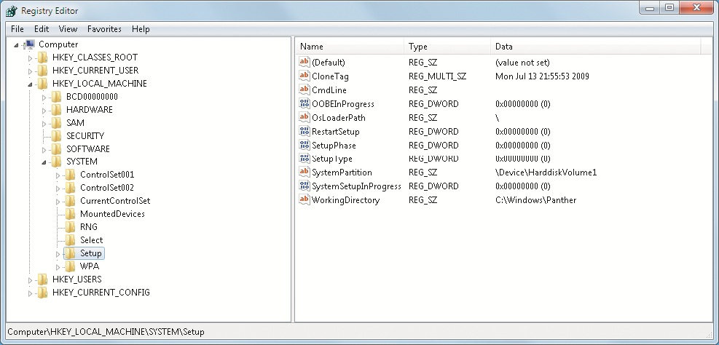
Registry Editor Window

Slide 17
Registry Structure (cont'd.)
Registry maintains its own security settings
  To restrict which entities can read or change keys
HKEY_CLASSES_ROOT
  Settings define the types (classes) of documents and properties associated with those types
HKEY_CURRENT_USER
  Settings in this hive define the preferences of the currently logged-on user

Slide 18
Registry Structure (cont'd.)
HKEY_LOCAL_MACHINE
  Global settings for entire computer and applications
HKEY_USERS
  Multiple subsections to define user-specific settings for new users and any user who ever logged on
HKEY_CURRENT_CONFIG
  Details about the current hardware profile in use

Slide 19
Registry Editing Tools
REGEDIT.EXE
  Graphical Registry editor
  Allows user to:
    Connect to the active registry database
    Make changes that are effective immediately
REG.EXE
  Command-line tool
  Used to read data from or write data to the registry from inside a scripted batch or command file
  Requires intimate knowledge of the registry’s hierarchy and values

Slide 20
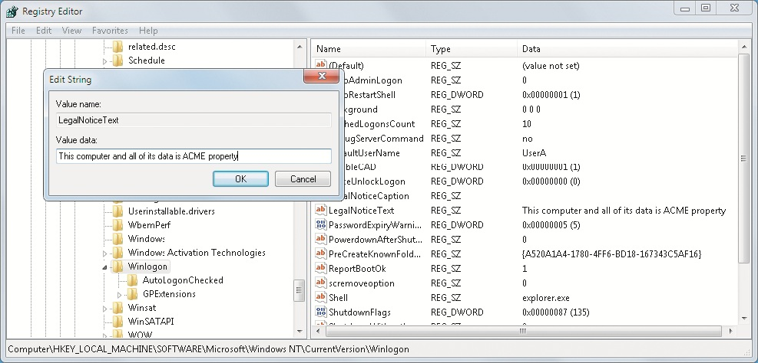
Registry Editing Tools (cont'd.)

Slide 21
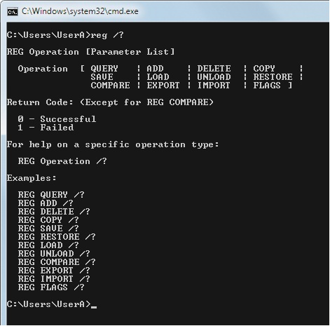
Registry Editing Tools (cont'd.)

Slide 22
Registry Backup and Restore Methods
Both REGEDIT.EXE and REG.EXE
  Can export the current settings from part of the registry database to a text-based file
    File has a .REG extension
Backing up the entire registry
  Perform a complete PC backup
    Including the system state of the operating system
A user may import a .REG file

Slide 23
Registry Security
Registry database is protected by its own security system
Each key is assigned permissions, an owner, and optionally a list of users to audit when the key is accessed
Access to a registry key and the values it contains can be explicitly allowed or denied
  Based on the user or the groups they belong to
Basic permissions usually do not reveal all of the fine security details that exist

Slide 24
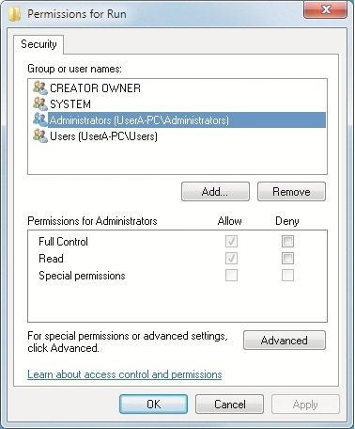
Registry Security (cont'd.)

Slide 25
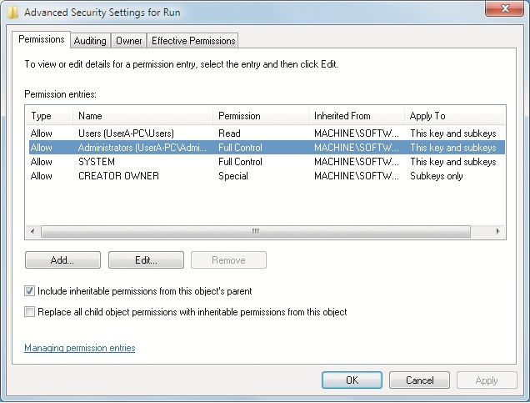
Registry Security (cont'd.)

Slide 26
Registry Security (cont'd.)
Security settings are inherited from the top of the hive down to the bottom of the hive
Permission inheritance and default security options should not be changed
  Without a good reason to do so
Owner of the keys is usually listed as SYSTEM
In Windows 7, the operating system code and services run in a user session
  If registry permissions are altered, the registry data may not be available to the operating system

Slide 27
File and Registry Virtualization
Some pre-Windows Vista applications store data and configuration settings
  In file and registry locations not meant for this purpose
With User Account Control
  Windows 7 can distinctly recognize and control access to sensitive system areas
32-bit version of Windows 7 has virtualized select system file and registry areas

Slide 28
File and Registry Virtualization (cont'd.)
Key system areas that are virtualized include:
  HKLM\Software
  %SystemRoot%
  %ProgramFiles%
UAC-aware applications can include an XML file called the application manifest
  Can identify the application as UAC aware, which disables UAC file and registry virtualization automatically for that application

Slide 29
Run As Administrator
Applications run with the same security privileges as the currently logged-on user
Run As option existed to run an application as a different user
  Modified in Windows 7
  Now known as the Run As Administrator option
Details of the security privileges for the currently logged-on user are stored in a security token
  Compiled when the user first logs on
Useful when a program must run at an elevated level

Slide 30
Application Compatibility
Some applications designed for older operating systems will not work smoothly with Windows 7
Compatibility options
  Windows 7 can emulate an operating system closer to what the application was first written for
  Windows 7 can try to emulate a range of older Windows OS environment
Compatibility setting can be configured using:
  Program Compatibility Assistant
  Manually through Program Compatibility Settings

Slide 31
Program Compatibility Assistant
When an application is run for the first time
  Windows 7 automatically checks if the application has an issue
    If there is an issue, the Program Compatibility Assistant will launch the next time the same application runs
Program Compatibility Assistant
  Designed to make it easy for users to adjust their legacy applications to work with Windows 7
    Without having to know a lot about compatibility settings

Slide 32
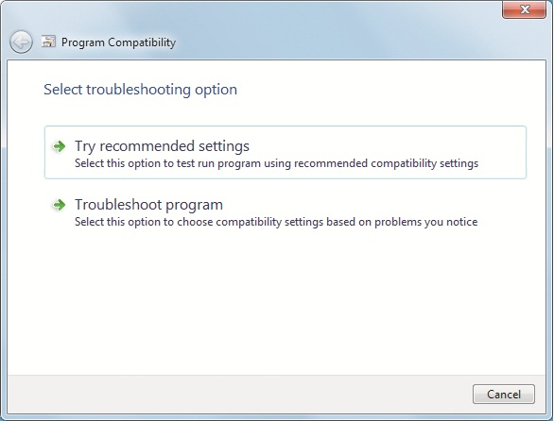
Program Compatibility Assistant (cont'd.)

Slide 33
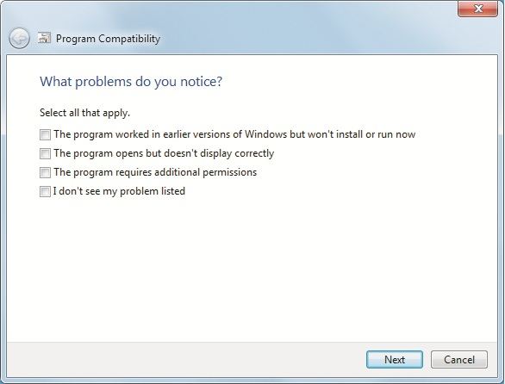
Program Compatibility Assistant (cont'd.)

Slide 34
Program Compatibility Settings
Once an application is installed
  It can optionally have its compatibility settings adjusted as part of its properties
Program’s compatibility settings can be viewed and changed through the Compatibility tab in the program’s Properties window

Slide 35
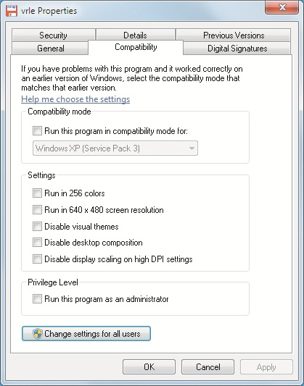
Program Compatibility Settings (cont'd.)

Slide 36
XP Mode
Installs a second virtual operating system that runs at the same time as Windows 7
Made possible by installing a free copy of Virtual PC and operating system enhancements
Has specific enhancements that link applications between Windows 7 and Windows XP
Copy of Windows XP in the virtual machine still needs to be managed and protected

Slide 37
Kernel Patching
Kernel patching
  System whereby applications modify the core functionality of the Windows operating system
    To obtain low-level access to the operating system and its resources
  Considered a security risk
  Can cause operating system instability if not done properly
Windows 7 prevents kernel patching by untrusted applications

Slide 38
Application Compatibility Research Tools
Primary compatibility research tool:
  Microsoft Application Compatibility Toolkit (ACT) V5.5
Microsoft ACT V5.5 is currently available as a free download from Microsoft
  Tool is a lifecycle management tool for the applications required by a user or company
  Assists in identifying and managing which applications must be reviewed

Slide 39
Application Compatibility Research Tools (cont’d.)
Application Compatibility Manager
  Administrative console that the IT administrator uses to control the overall discovery, collection, and analysis process
Compatibility Administrator
  Tool for the IT administrator to collect and resolve compatibility issues
Standard User Analyzer
  Tool that monitors what happens when an application is run as a user without elevated permissions

Slide 40
Application Compatibility Research Tools (cont’d.)
Setup Analysis tool
  Observes what steps and changes are made during the installation of an application
Internet Explorer Compatibility Test Tool
  Monitors what happens when a Web site is opened in Internet Explorer 7 or 8
Microsoft Compatibility Exchange
  Allows the Application Compatibility Manager to connect to external knowledge bases
Application shims can be used to interact between the application and the operating system

Slide 41
Application Control Policies
Getting applications to run is only part of the IT administrator’s role
Control policies available to the IT administrator include:
  Software Restriction Policies
  AppLocker

Slide 42
Software Restriction Policies
Implemented as part of a management strategy
  For Windows XP workstations that are domain-joined to a Windows Server 2003 domain
Typically created using an MMC Group Policy snap-in on an Active Directory domain server to create a Group Policy Object (GPO)
Mistake can have serious consequences to the ability of workstations to operate
Default behavior is set to allow all applications to run by default

Slide 43
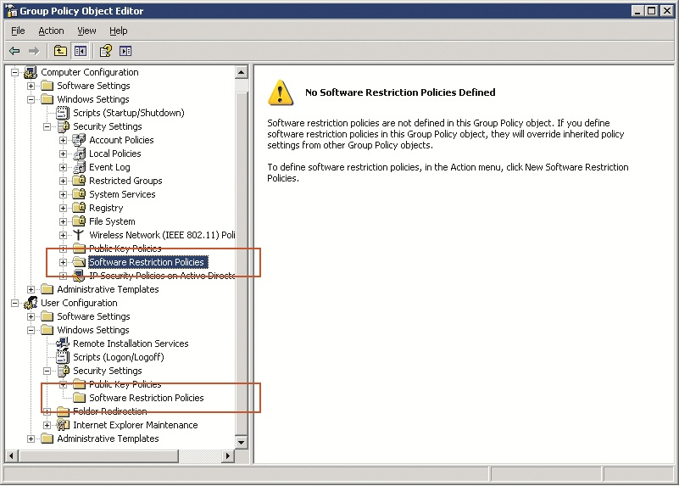
Software Restriction Policies (cont’d.)

Slide 44
Software Restriction Policies (cont’d.)
Additional rule types that can be created as exceptions include:
  Hash Rule
  Path Rule
  Internet Zone Rule
  Certificate Rule
  Registry Key Rule
Software restriction policies know about most executable file types based on their file extension
Restriction policies are delivered by Group Policy

Slide 45
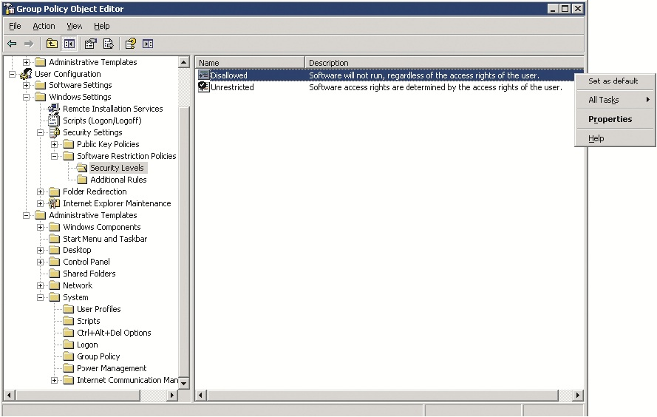
Software Restriction Policies (cont’d.)

Slide 46
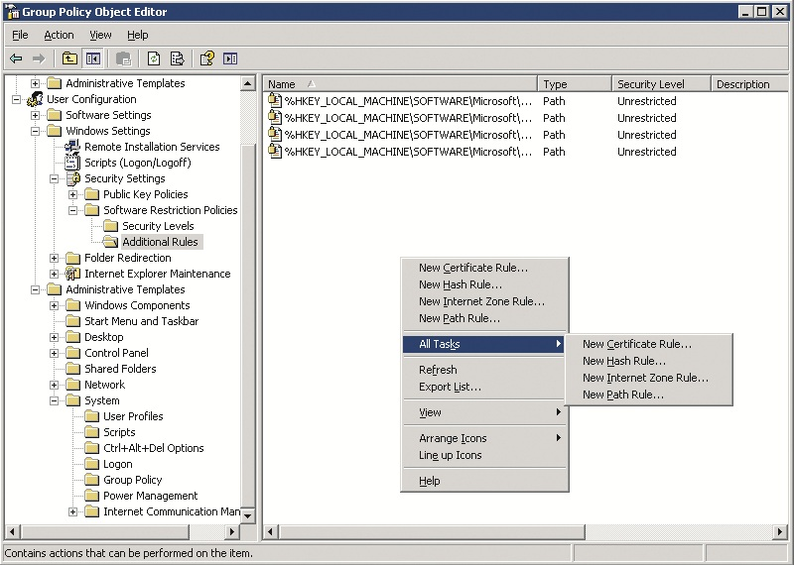
Software Restriction Policies (cont’d.)

Slide 47
AppLocker
Choice of applications has changed with time
AppLocker
  Replacement management strategy for limiting applications allowed to run
  Relies on Group Policy Objects just as the older software restriction policies do
Advantage in using AppLocker
  Works better as a management strategy with the current application landscape

Slide 48
Summary
Application architecture and its layers as they apply to the execution of the user’s applications and the operating system itself
Different application environments are supported for DOS, Win16, and Win32 in the 32-bit version of Windows 7
Registry in Windows 7 is based on the original Windows NT registry model
Select portions of the file system and registry are virtualized so that a running application believes it is writing to those locations

Slide 49
Summary (cont'd.)
Applications that require administrative privileges to run properly can be granted to Run as administrator
Legacy applications that have trouble running natively in Windows 7 can run in a compatibility mode that simulates an older version of Windows
Application compatibility is not a one-time operation that is only performed when a new operating system is introduced

